Slide 1
Plant Disease Detection using ML and UAV
By Manpreet Sandhu, Pratik Hadawale, Saumaan Momin, Ajitkumar Khachane

Slide 2
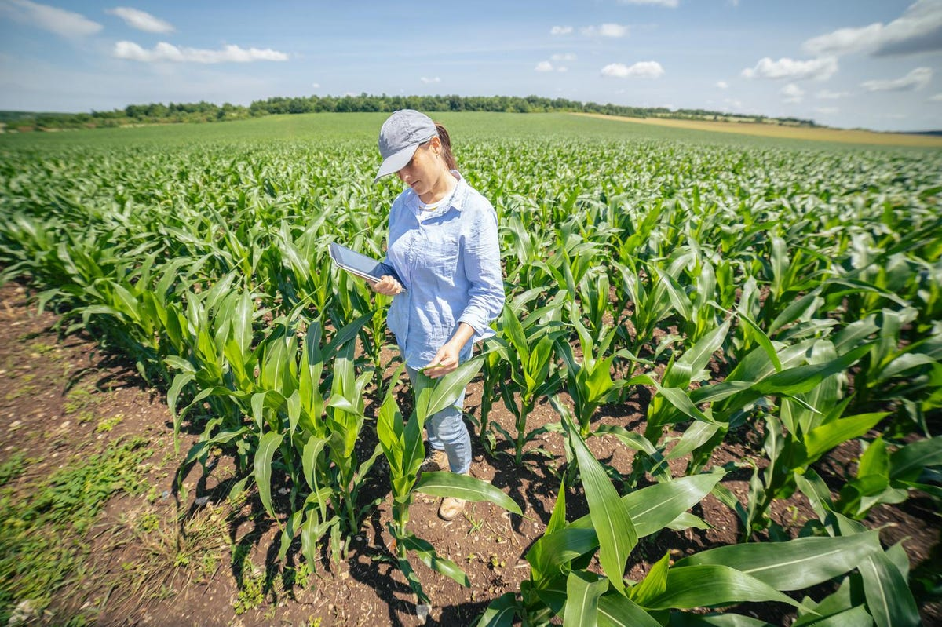
Manual Checking of plants

Slide 3
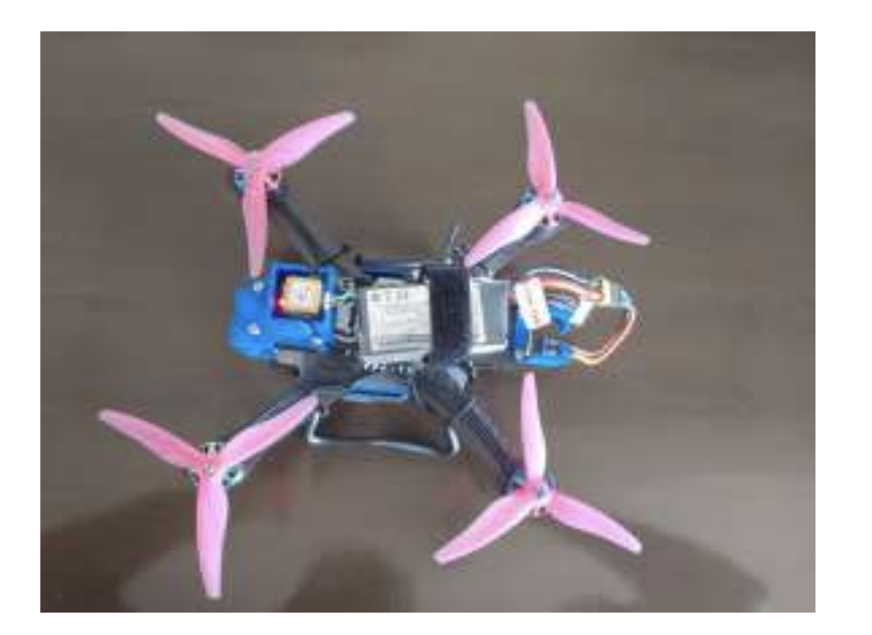
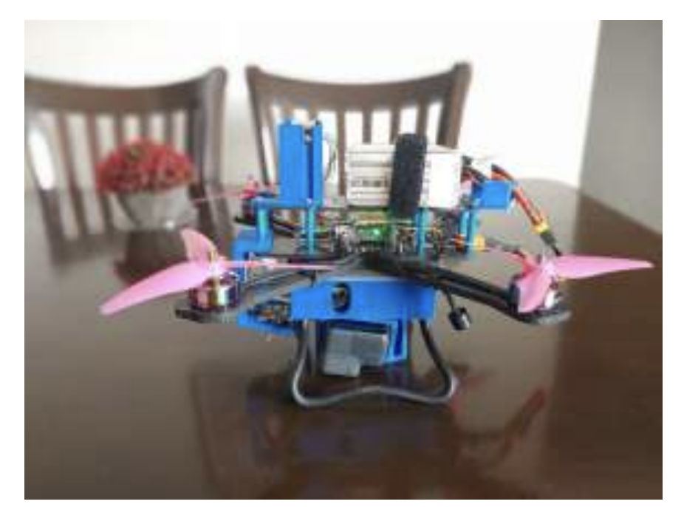
Drone

Slide 4
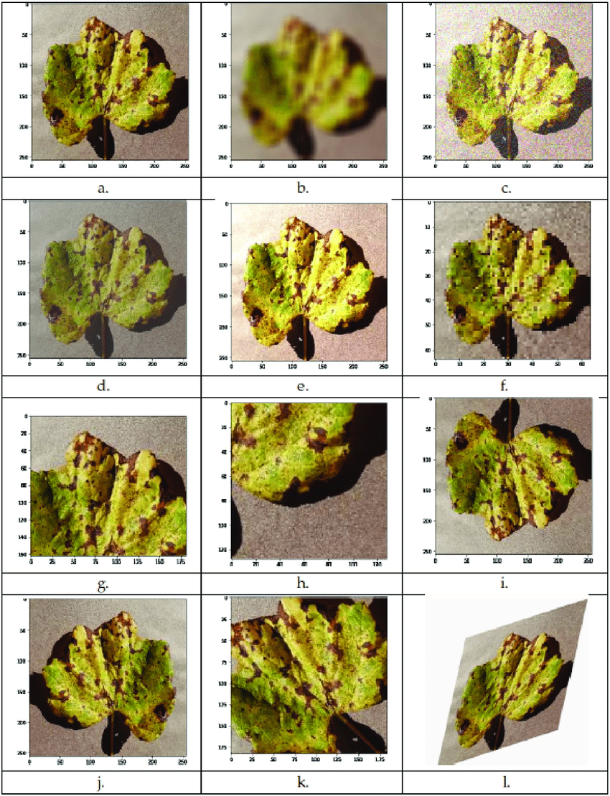
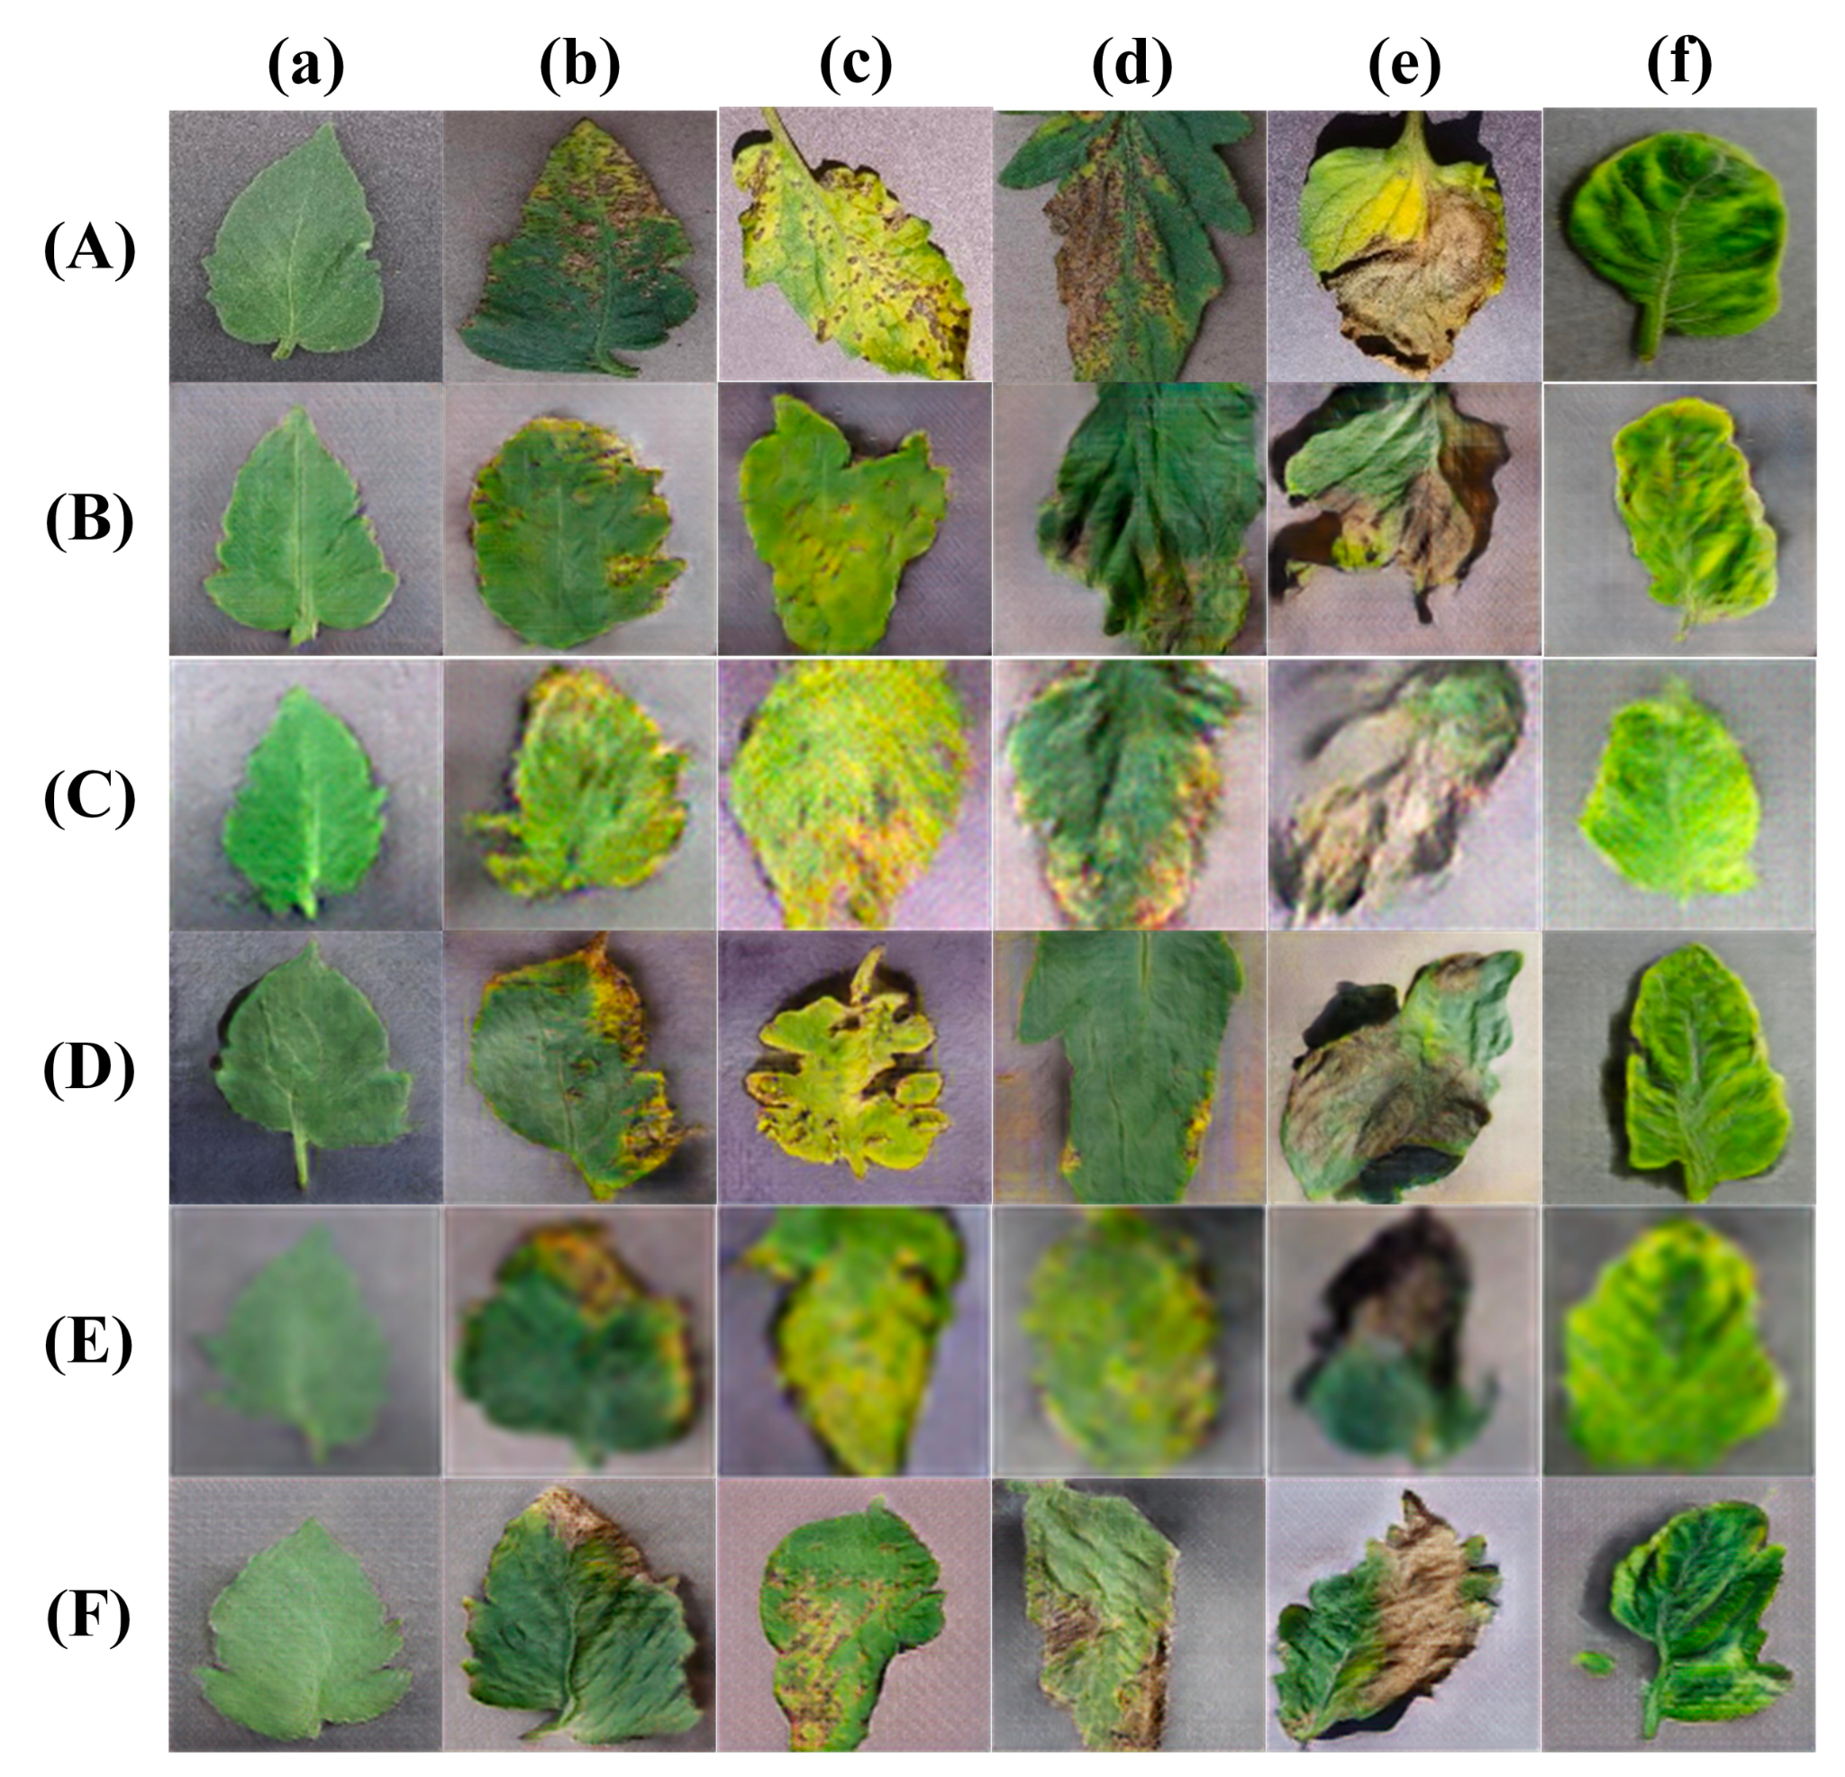
Data Augmentation

Slide 5
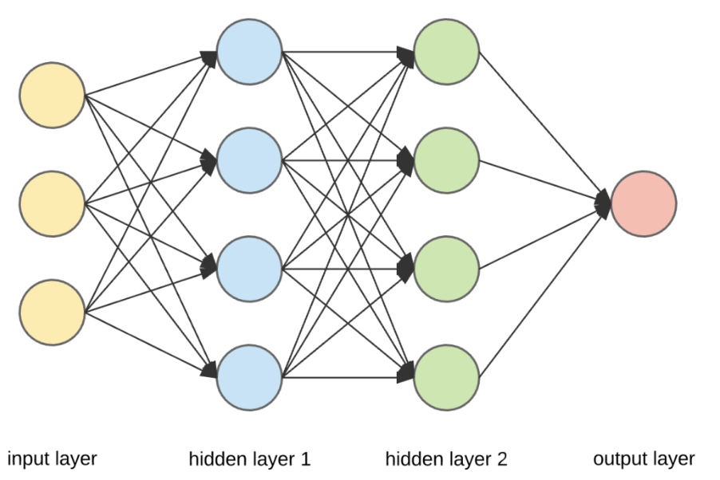
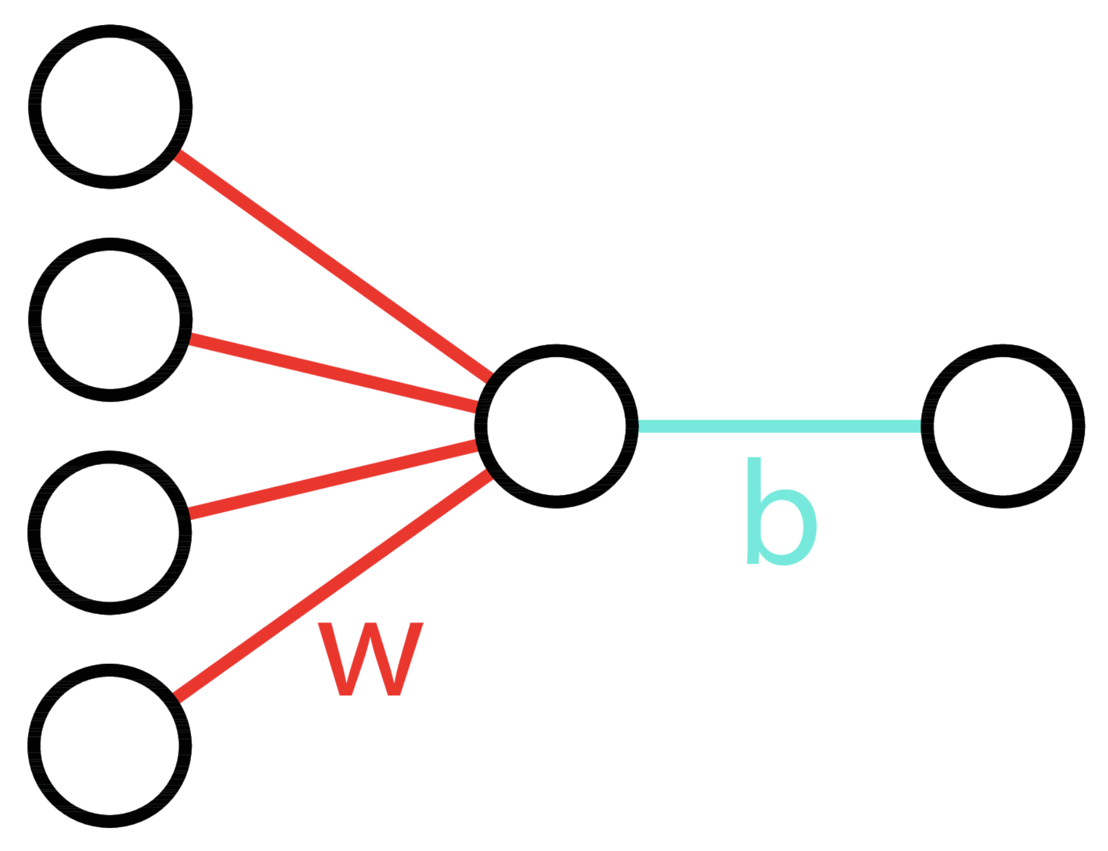
Neural Network

Slide 6

Models
Inception V3

Slide 7
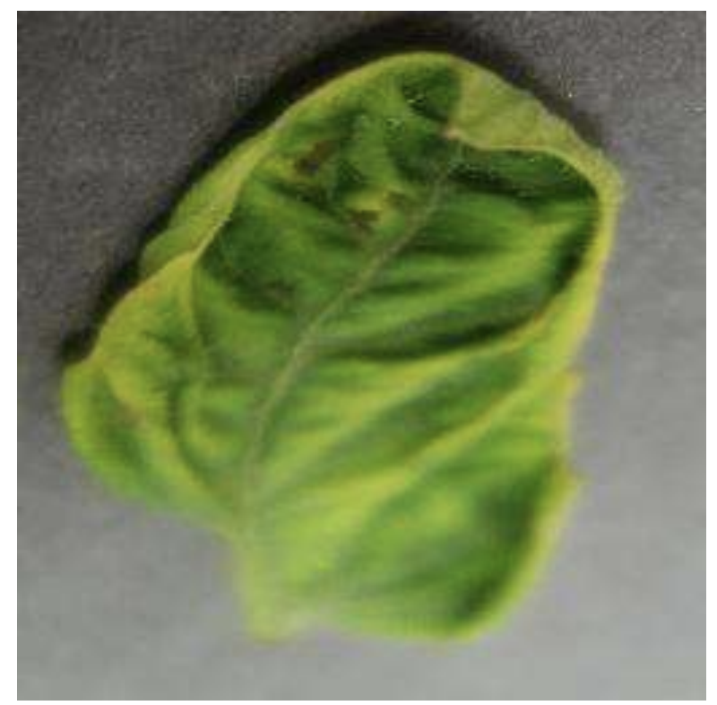
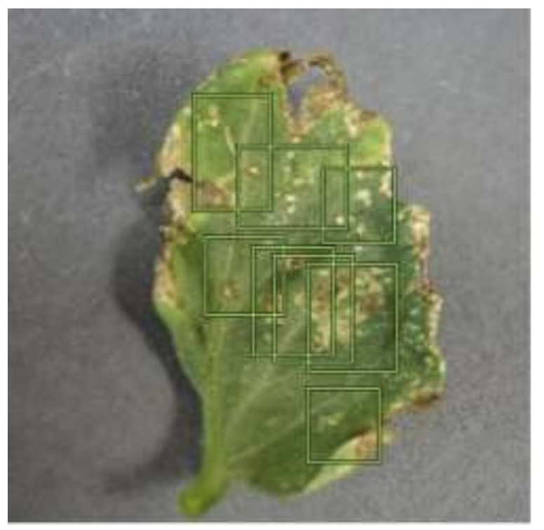
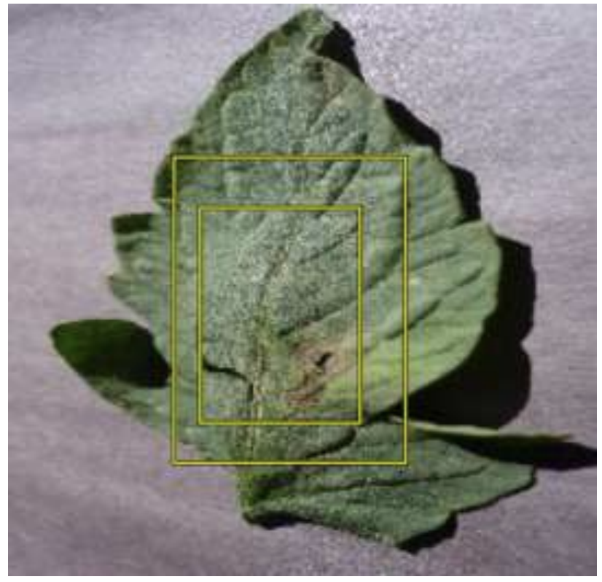
Input
Input Image
Inception V3
Google’s AutoML

Slide 8
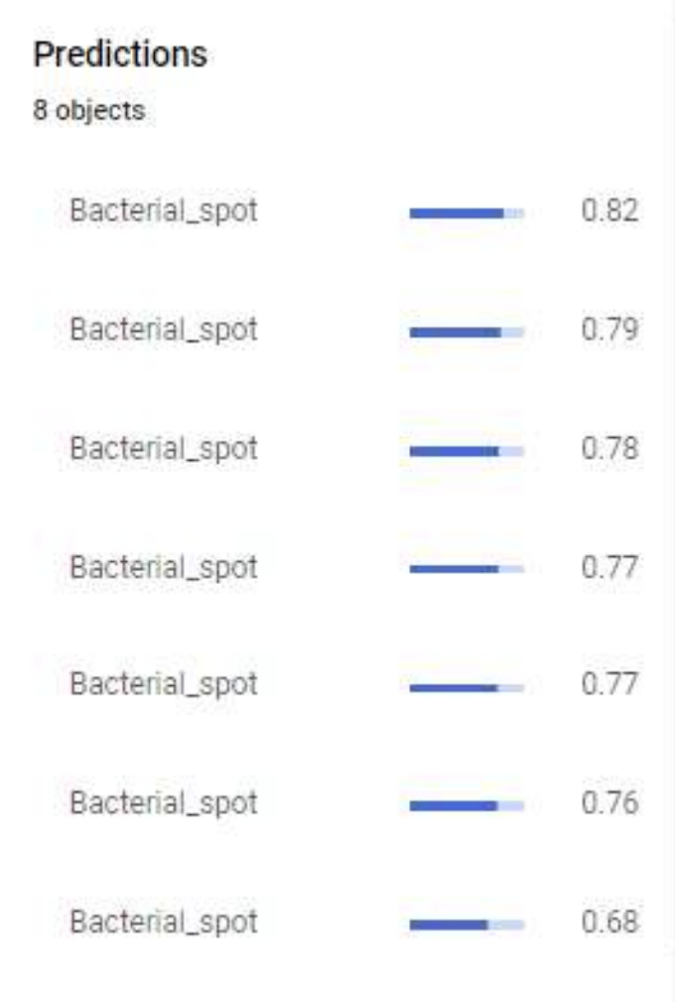
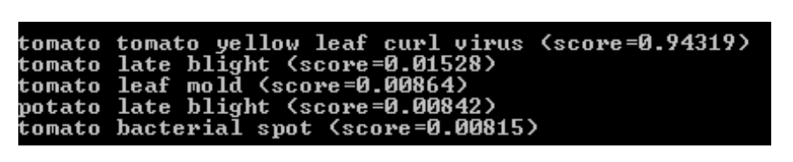
Results
Inception V3
Google’s AutoML

Slide 9
Thank You

